Slide 1






Sant Longowal institute of engineering and technology
(Deemed-to-be University Under Ministry of Education, Govt. of India)
SMES
(SLIET MECHANICAL ENGINEERING SOCIETY)
On the wheels to all-round excellence

Slide 2
National voters’ day
Today is National Voters Day 2023, a day set aside for educating people about the value of the voting and inspiring them to take part in the election process.
The Indian Election Commission also provides voter ID cards to new voters on this day.
In India, National Voters Day is observed annually on January 25. Annual celebrations of National Voters Day have a specific theme.
The Election Commission of India (ECI), which was established in 1950, was founded on January 25. In 2011, this day was initially observed.

Slide 3
The purpose of this day is to emphasize the significance of voting and each and every vote, to inspire young people to participate in the democratic process, and to emphasize the importance of the fundamental right to vote.
The government of India was chosen democratically. Everyone has the fundamental right to cast a ballot.
She/he has the authority to choose their representative from a group of people they believe are qualified to lead the country, solve problems faced by regular people, transform lives, etc.
Being aware of National Voters Day in India is crucial because the future of our country rests on the leader we choose.

Slide 4

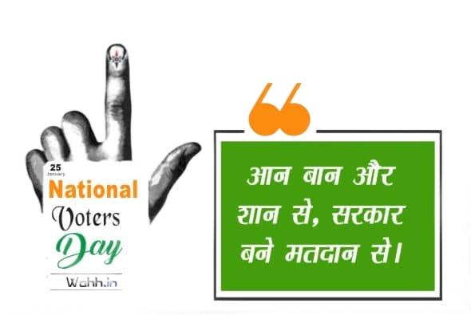
“NOTHING LIKE VOTING,
I VOTE FOR SURE”
“
THANK YOU

